Slide 1
Lab Experiment 07 Switching Characteristics of MOSFET
Department of Electrical & Computer Engineering
North South University
Analog Electronics I Lab
EEE111L
Spring 2021
Sec: 11

Slide 2
Objective
To study the switching characteristics of MOSFET
Enhancement n-type MOSFET

Slide 3
Theoretical Concept
Basic knowledge about MOSFET
Transfer Characteristics &
Output Characteristics of enhancement n-type of MOSFET

Slide 4
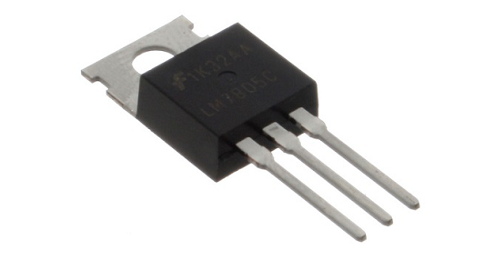
MOSFET
→ Tri-terminal, uni-polar, voltage-controlled, high input impedance device
→classified into two types viz., depletion-type and enhancement-type

Slide 5
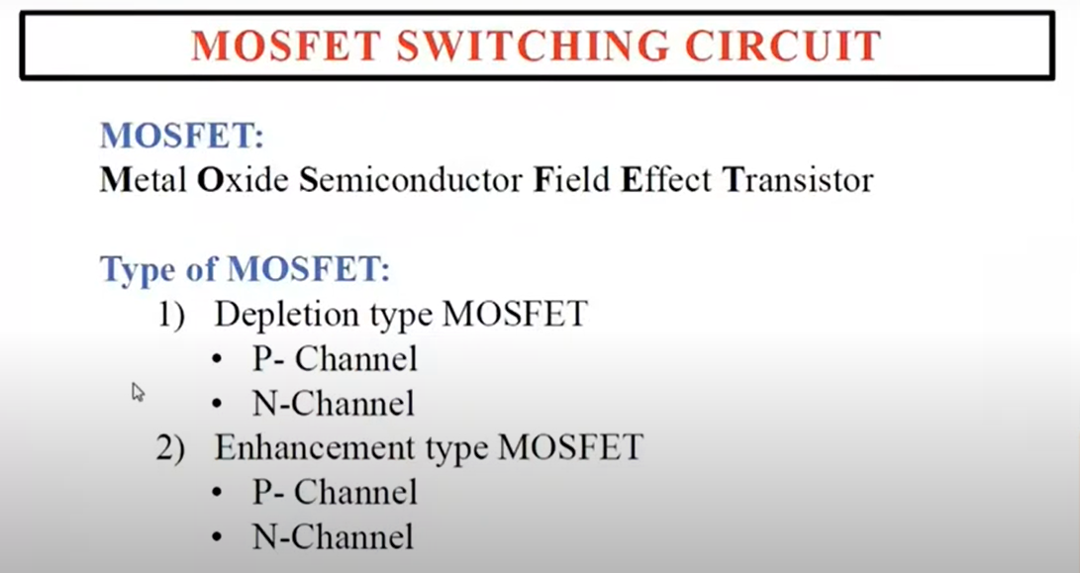

Slide 6
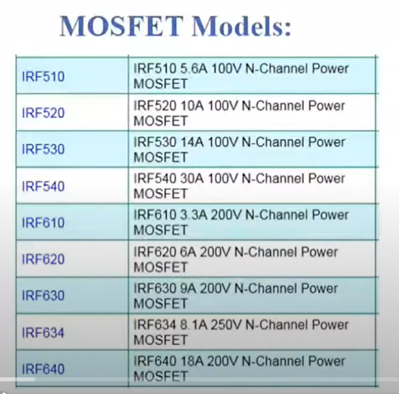
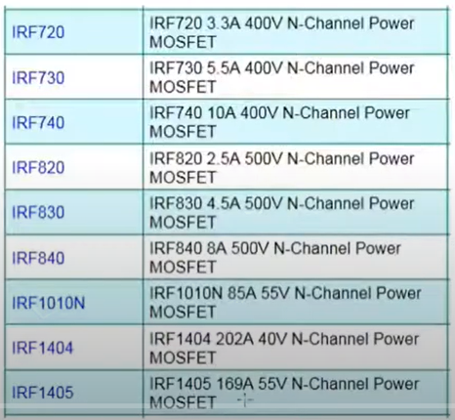

Slide 7
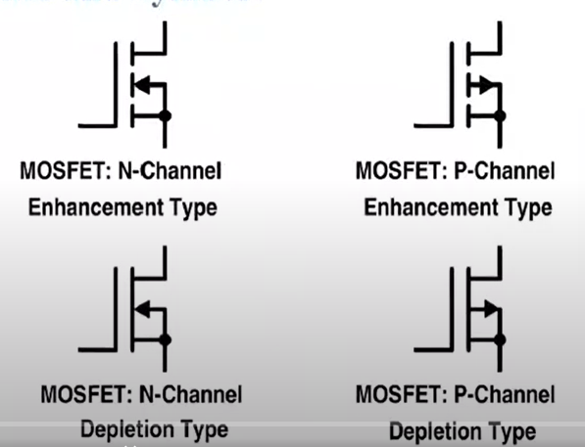
MOSFET’s Symbols

Slide 8
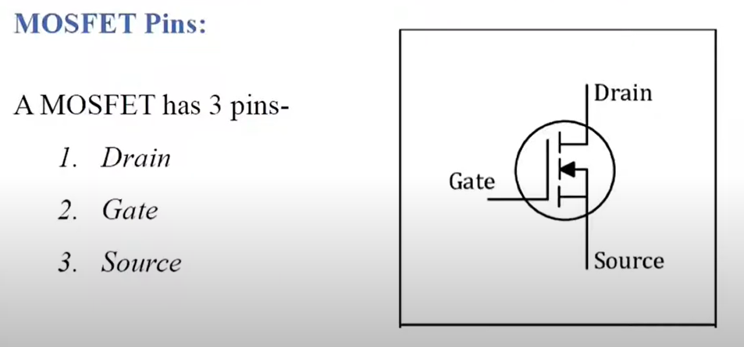

Slide 9
Equipments
Resistor
DC power Supply
Connecting Wires
DMM
IRF540

Slide 10
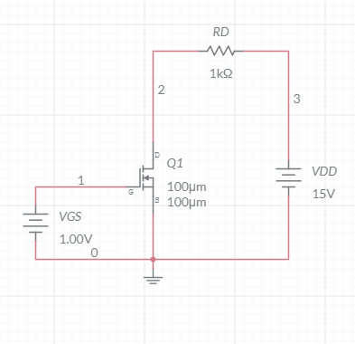
Experimental Circuits

Slide 11
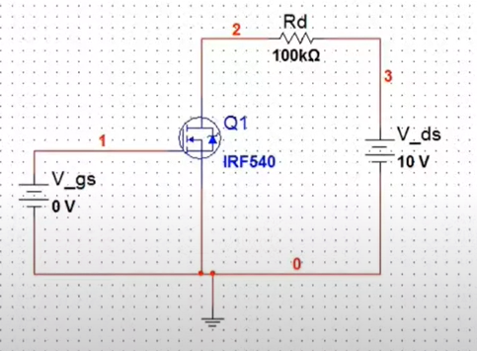
Experimental Circuit

Slide 12
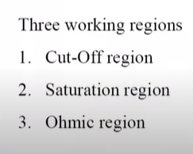
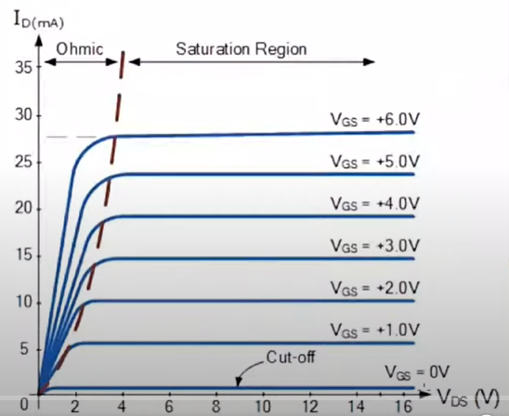
MOSFET Output Characteristics

Slide 13
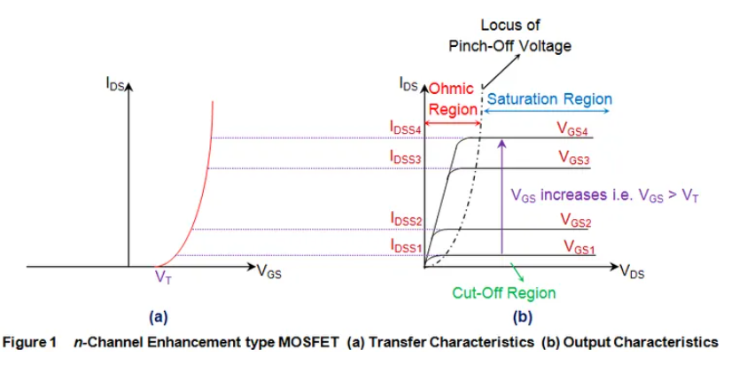
Characteristics Curves

Slide 14
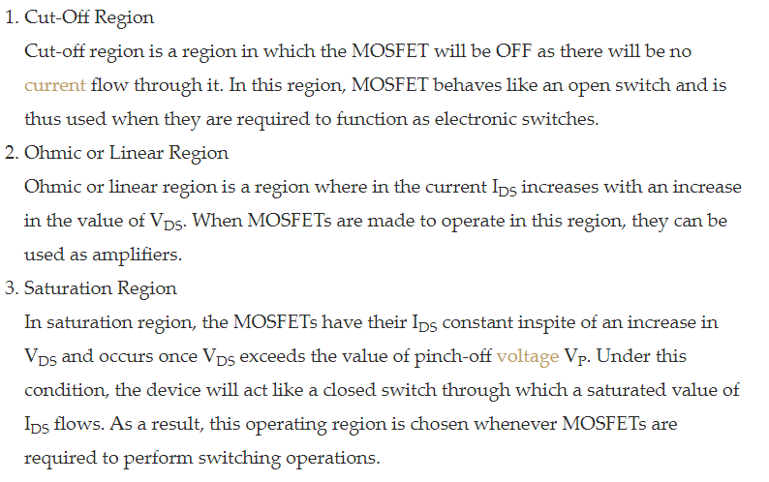
MOSFET’s operating regions

Slide 15
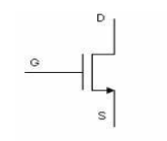
MOSFET Voltage controlled Device & It acts as a switch
A voltage input to the gate controls the flow of current from source to drain. The gate does not draw a continuous current. Though, the gate draws a surge of current to charge the gate capacitance.

Slide 16
Notes:
Threshold voltage is the voltage applied between gate and source of a MOSFET that is needed to turn the device on for linear and saturation regions of operation.
The value of the threshold voltage is dependent from some physical parameters which characterize the MOSFET structure such as: the gate material, the thickness of oxide layer, substrate doping concentrations (density) NA, oxide –interface fixed charge concentrations (density), channel length L, channel width W

Slide 17
Circuit Construction :
To select IRF540:
Click on Place Basic
Click on Select all families
Under Component type “IRF540” and select it

Slide 18
Simulation
Click on “Simulate”
Click on “Analysis”
Select “Parameter Sweep”

Slide 19
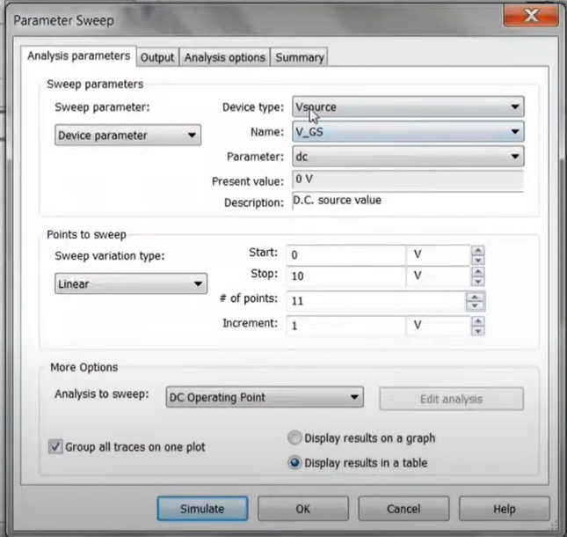
Parameter Sweep→ Analysis Parameters

Slide 20
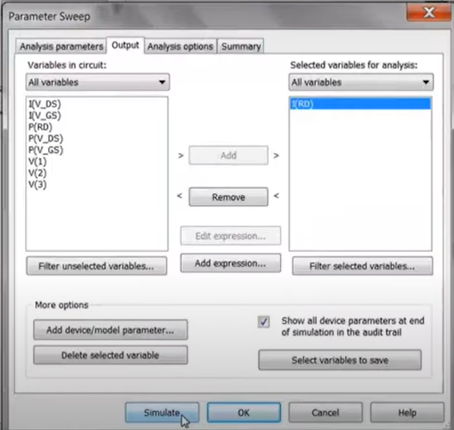
Parameter Sweep→ Output→ Add “I(RD)” →Simulate

Slide 21
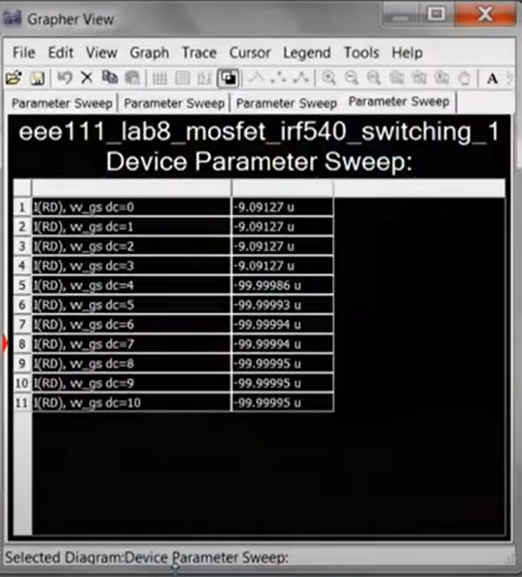
Parameter Sweep for Vds = 10V

Slide 22
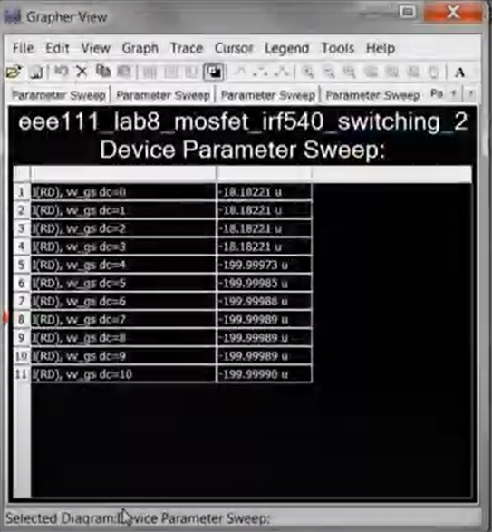
Parameter Sweep when V_ds = 20 V

Slide 23
References:
https://www.youtube.com/watch?v=P_qwv1SIQsY
https://www.electrical4u.com/mosfet-characteristics/

